Slide 1
Theory of Computation
CSE-3101
Md. Manowarul Islam
Lecturer, Dept of CSE
JnU

Slide 2
What is Automata Theory?
Study of abstract computing devices, or “machines”
Automaton = an abstract computing device
  Note: A “device” need not even be a physical hardware!
A fundamental question in computer science:
  Find out what different models of machines can do and cannot do
  The theory of computation
Computability vs. Complexity
Md. Manowarul Islam, Dept. of CSE, JnU

Slide 3
Alphabet
An alphabet is a finite, non-empty set of symbols
We use the symbol ∑ (sigma) to denote an alphabet
Examples:
  Binary: ∑ = {0,1}
  All lower case letters: ∑ = {a,b,c,..z}
  Alphanumeric: ∑ = {a-z, A-Z, 0-9}
  DNA molecule letters: ∑ = {a,c,g,t}
  …
Md. Manowarul Islam, Dept. of CSE, JnU

Slide 4
Strings
A string or word is a finite sequence of symbols chosen from ∑
Empty string is ε (or “epsilon”)
Length of a string w, denoted by “|w|”, is equal to the number of (non- ε) characters in the string
  E.g., x = 010100 |x| = 6
  x = 01 ε 0 ε 1 ε 00 ε |x| = ?
  xy = concatentation of two strings x and y
Md. Manowarul Islam, Dept. of CSE, JnU

Slide 5
Powers of an alphabet
  Let ∑ be an alphabet.
  ∑^{k} = the set of all strings of length k
  ∑* = ∑⁰ U ∑¹ U ∑² U …
  ∑⁺ = ∑¹ U ∑² U ∑³ U …
Md. Manowarul Islam, Dept. of CSE, JnU

Slide 6
Languages
L is a said to be a language over alphabet ∑, only if L ⊆ ∑*
  ➔ this is because ∑* is the set of all strings (of all possible length including 0) over the given alphabet ∑
Example
  Let L be the language of all strings consisting of n 0’s followed by n 1’s:
  Ans: L = {ε,01,0011,000111,…}
  Let L be the language of all strings of with equal number of 0’s and 1’s:
  Ans: L = {ε,01,10,0011,1100,0101,1010,1001,…}
Definition: Ø denotes the Empty language
Md. Manowarul Islam, Dept. of CSE, JnU

Slide 7
The Membership Problem
Given a string w ∈∑*and a language L over ∑, decide whether or not w ∈L.
Example:
Let w = 100011
Q) Is w ∈ the language of strings with equal number of 0s and 1s?
Md. Manowarul Islam, Dept. of CSE, JnU

Slide 8
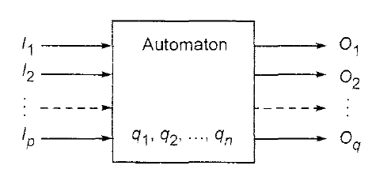
Automata
Automaton = an abstract computing device
An automata is an abstract model of a computer that accept some input (a string), produce some out put (yes or no or another string)
Input
Output
State
State relation
Output relation
Md. Manowarul Islam, Dept. of CSE, JnU

Slide 9
Finite automata
An automaton which output depends on the current state as well as depends on input is called FA.
A finite automaton is a 5-tuple M = (Q,Σ, δ, q, F), where
Q is a finite set, whose elements are called states
Σ is a finite set, called the alphabet; the elements of Σ are called symbols
δ : Q × Σ → Q is a function, called the transition function
q is an element of Q; it is called the start state
F is a subset of Q; the elements of F are called accept states
Md. Manowarul Islam, Dept. of CSE, JnU

Slide 10
Finite Automata
Some Applications
  Software for designing and checking the behavior of digital circuits
  Lexical analyzer of a typical compiler
  Software for scanning large bodies of text (e.g., web pages) for pattern finding
  Software for verifying systems of all types that have a finite number of states (e.g., stock market transaction, communication/network protocol)
Md. Manowarul Islam, Dept. of CSE, JnU

Slide 11
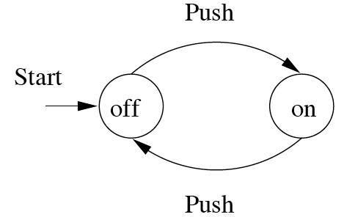
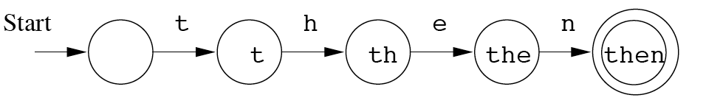
Finite Automata : Examples
action
On/Off switch
Modeling recognition of the word “then”
state
Start state
Transition
Intermediate
state
Final state
Md. Manowarul Islam, Dept. of CSE, JnU

Slide 12
Summary
Automata theory
Finite automata
Alphabets, strings/words/sentences, languages.
Md. Manowarul Islam, Dept. of CSE, JnU

Slide 13
END
Md. Manowarul Islam, Dept. of CSE, JnU

